Slide 1
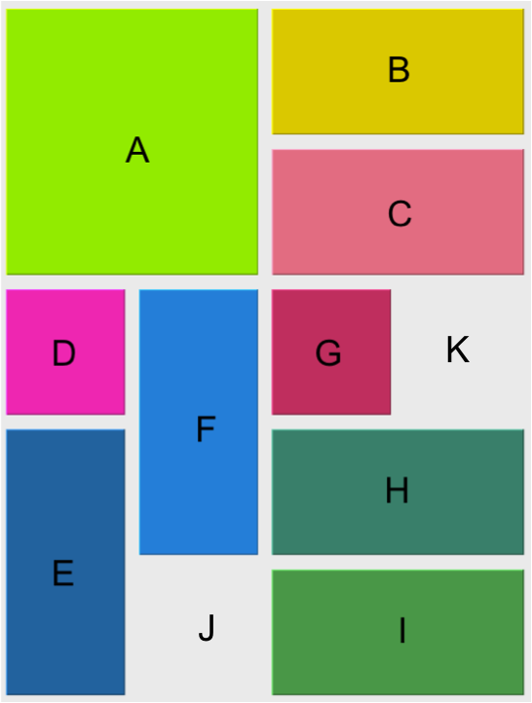
Point
Tray
Block
rowIdx
colIdx
upperLeft
width
height
0
rowSize
colSize
blocks
numBlocks
numBlanks
blanksSet
List
5
0
A
B
C
D
E
F
G
H
I
2
4
2
9
Point
2
rowIdx
colIdx
HashSet
4
J
K
1

